Slide 1





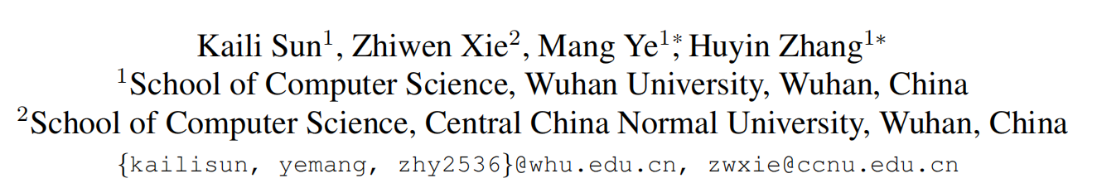





ATAI
Advanced Techniqueof Artificial Intelligence
ATAI
ChongqingUniversity _{AdvancedTechniqueof}
of Technology Artificial Intelligence
Chongqing University of
Technology
Chongqing University ^{ATAI}
_{of Technology} Advanced Techniqueof
Artificial Intelligence
Chongqing University of Technology
Chongqing University of Technology
Contextual Augmented Global Contrast for Multimodal Intent Recognition
Code:None
2024.7.11 •ChongQing
—— CVPR 2024
Reported by YaoChen Li
1

Slide 2

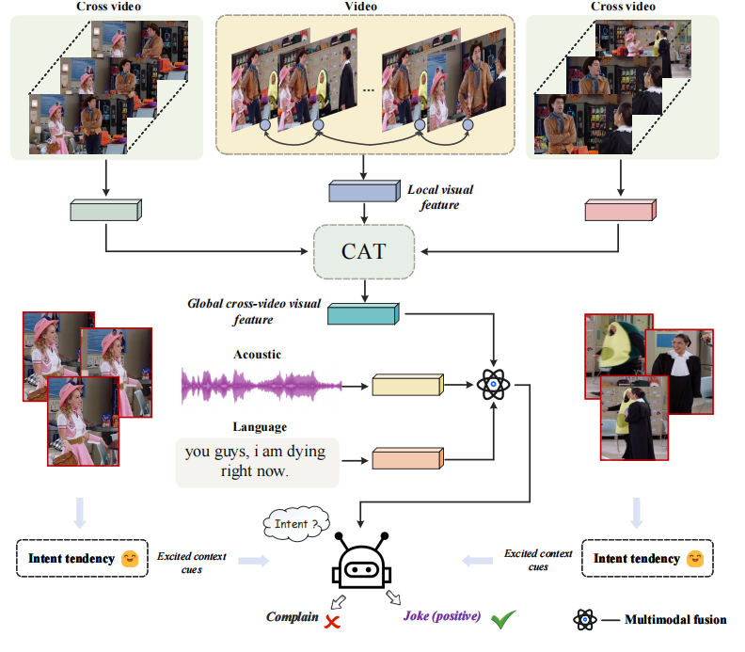
ATAI
AdvancedTechniqueof
Artificial Intelligence
ATAI
ChongqingUniversity _{AdvancedTechniqueof}
of Technology Artificial Intelligence
ChongqingUniversity of Technology
Motivation
(1)Existing methods tend to model the individual video independently, ignoring similarity information across videos.
(2)Existing contrastive learning methods ignore global information across videos, which often helps to capture richer features.

Slide 3

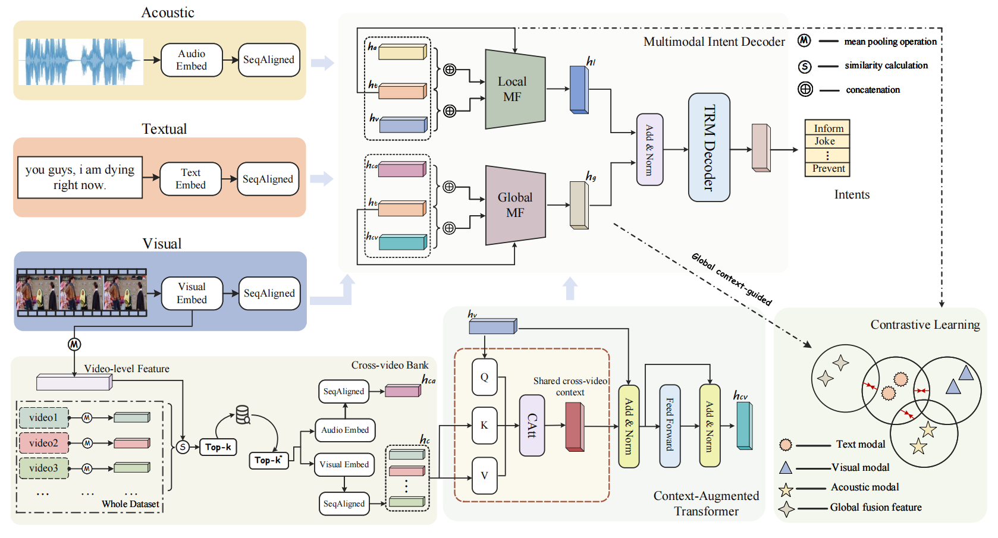
ChongqingUniversity of Technology
ATAI
AdvancedTechniqueof
Artificial Intelligence
ATAI
ChongqingUniversity _{AdvancedTechniqueof}
of Technology Artificial Intelligence
Overview

Slide 4
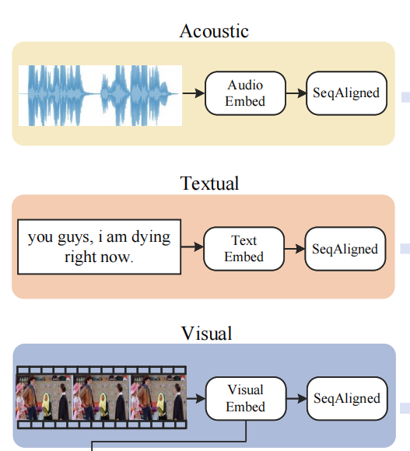
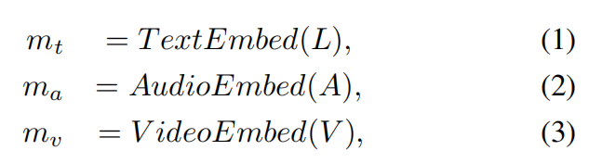

ChongqingUniversity of Technology
ATAI
AdvancedTechniqueof
Artificial Intelligence
ATAI
ChongqingUniversity _{AdvancedTechniqueof}
of Technology Artificial Intelligence
Overview

Slide 5

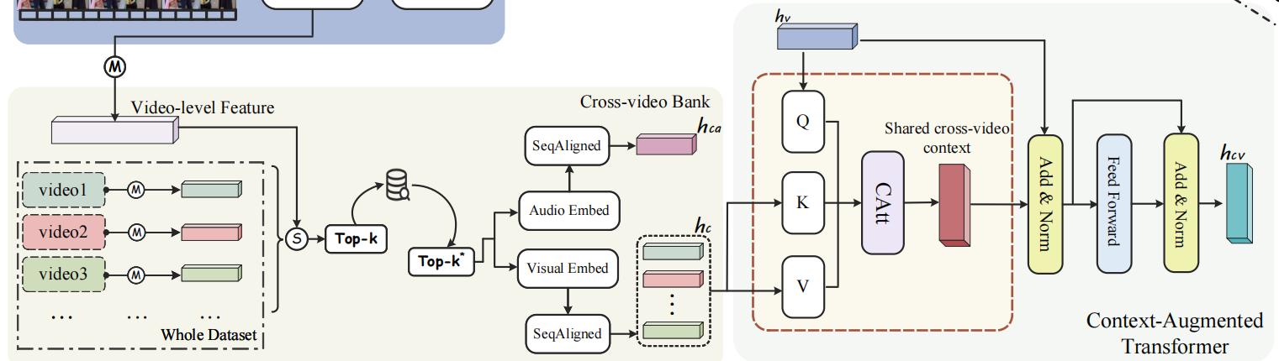
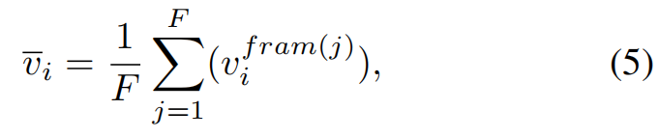

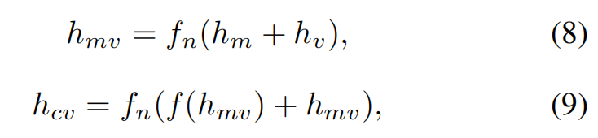
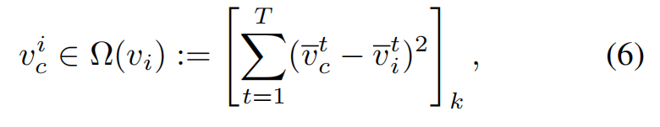
ChongqingUniversity of Technology
ATAI
AdvancedTechniqueof
Artificial Intelligence
ATAI
ChongqingUniversity _{AdvancedTechniqueof}
of Technology Artificial Intelligence
Method

Slide 6
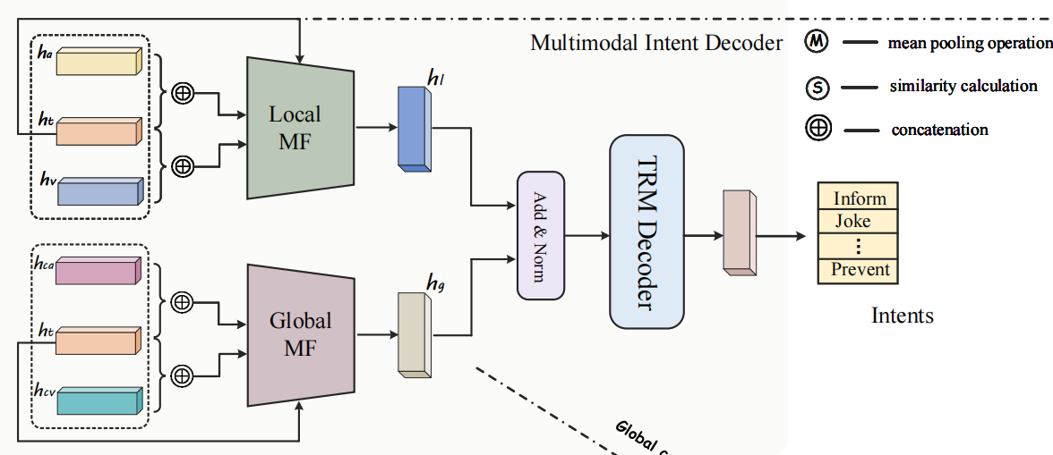
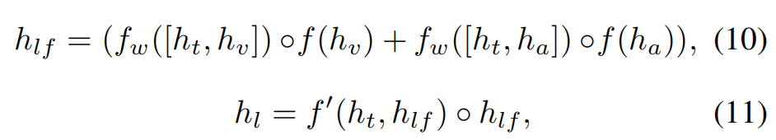
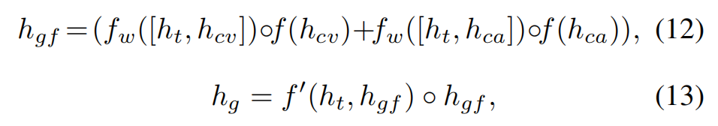
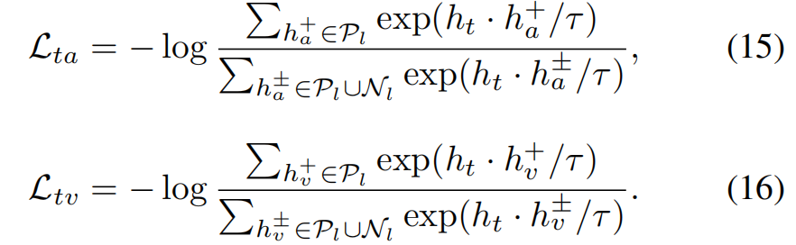
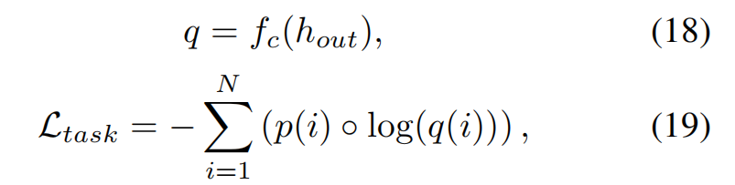

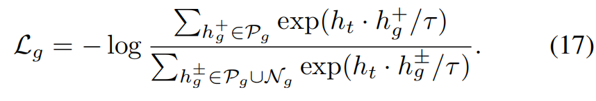
ChongqingUniversity of Technology
ATAI
AdvancedTechniqueof
Artificial Intelligence
ATAI
ChongqingUniversity _{AdvancedTechniqueof}
of Technology Artificial Intelligence
Method

Slide 7

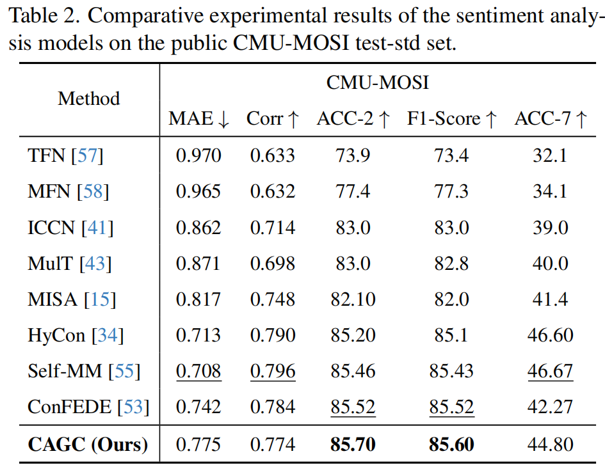
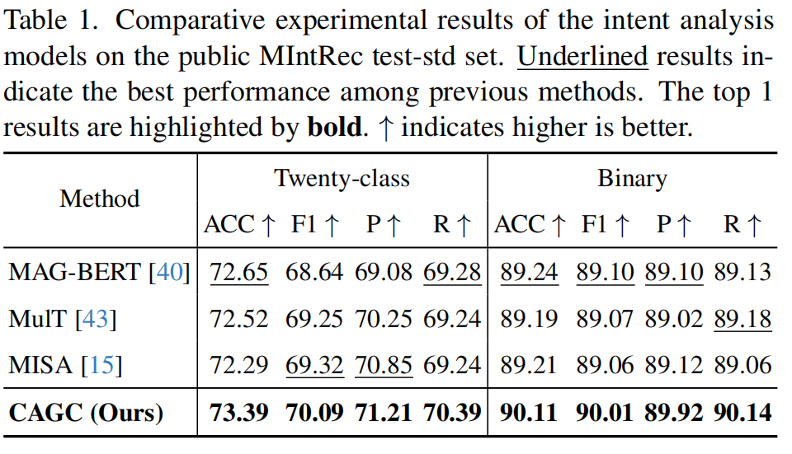
ATAI
AdvancedTechniqueof
Artificial Intelligence
ATAI
ChongqingUniversity _{AdvancedTechniqueof}
of Technology Artificial Intelligence
ChongqingUniversity of Technology
Experiments

Slide 8
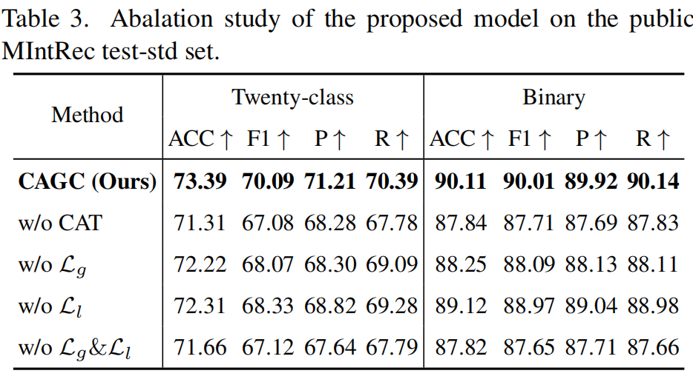
ATAI
AdvancedTechniqueof
Artificial Intelligence
ATAI
ChongqingUniversity _{AdvancedTechniqueof}
of Technology Artificial Intelligence
ChongqingUniversity of Technology
Experiments

Slide 9
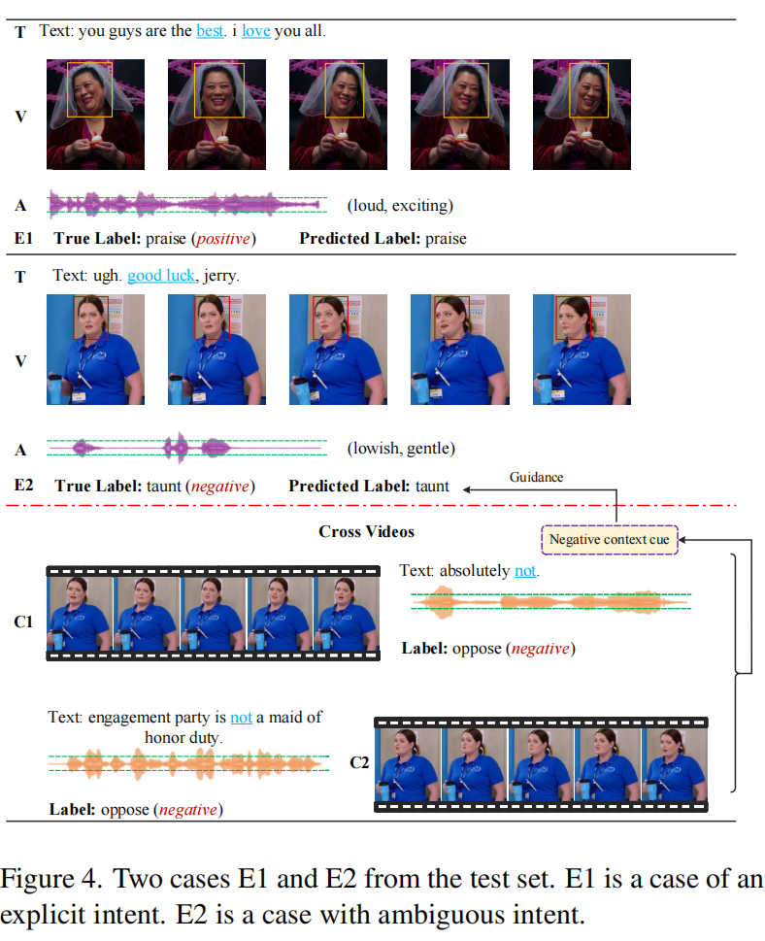
ChongqingUniversity of Technology
ATAI
AdvancedTechniqueof
Artificial Intelligence
ATAI
ChongqingUniversity _{AdvancedTechniqueof}
of Technology Artificial Intelligence
Experiments

Slide 10


ChongqingUniversity of Technology
ATAI
AdvancedTechniqueof
Artificial Intelligence
ATAI
ChongqingUniversity _{AdvancedTechniqueof}
of Technology Artificial Intelligence
Thanks!

